Slide 1
Interior and Exterior Angles of Polygons

Slide 2
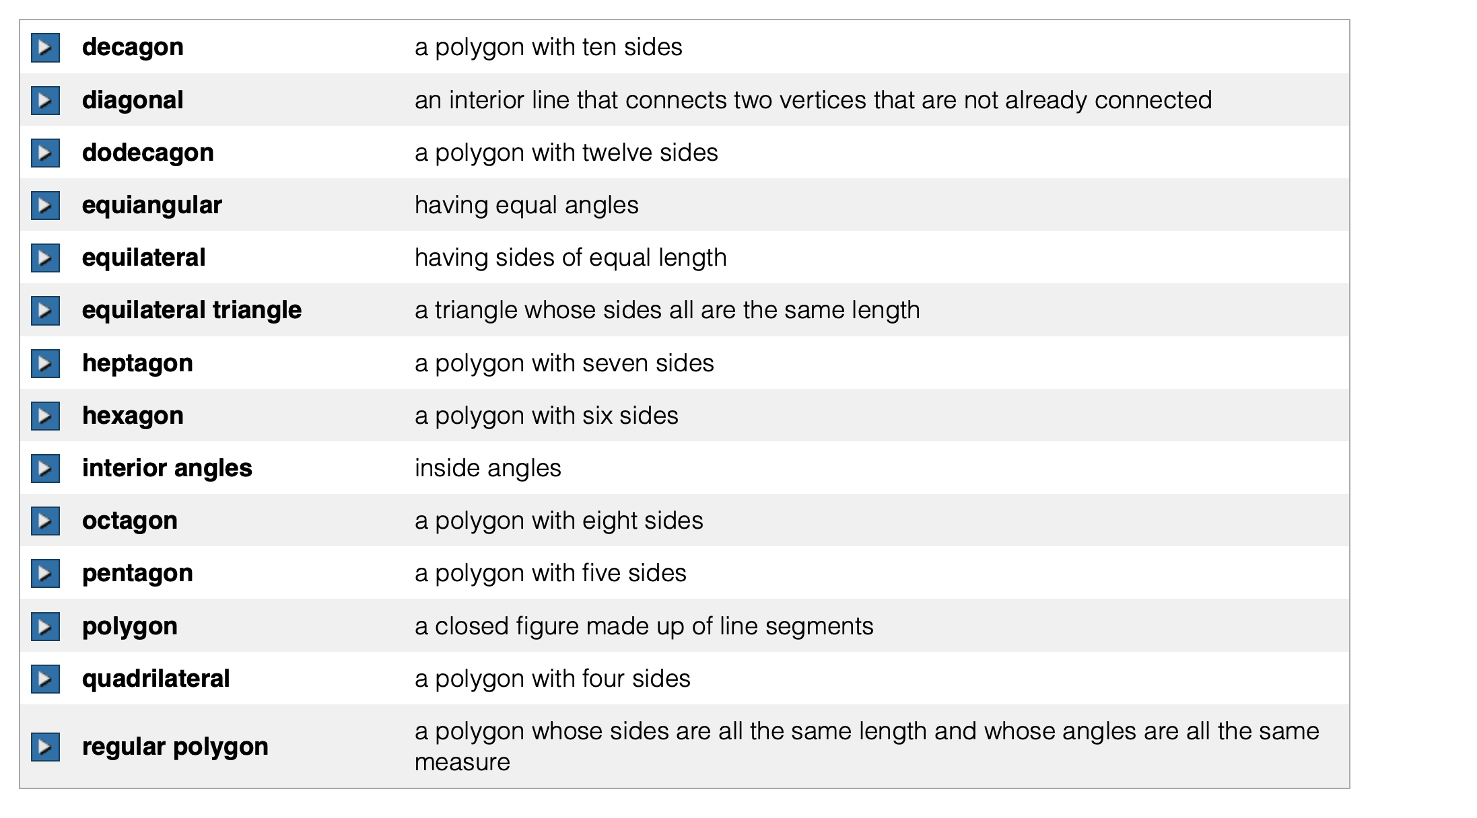
https://www.youtube.com/watch?v=zI3rUMrRLF8

Slide 3
Diagonals
A diagonal of a polygon is a segment that joins two nonconsecutive vertices.
Ex. 1. How many diagonals can we draw in the rectangle?

Slide 4
Triangles……
Ex. 2.
How many diagonals can be drawn in the triangle?
Why?

Slide 5
What is the sum of the interior angles of a triangle?
Ex. 3. Find the missing angles.
A
m<A =
m<B =
3xº
xº
72º
B
C

Slide 6
Quadrilaterals…
In each quadrilateral draw all possible diagonals from Vertex A.
How many triangles were formed as a result?
What do you think this means for the sum of the interior angles of a quadrilateral?

Slide 7
Pentagons….
In the following pentagon draw all possible diagonals from Vertex A.
How many triangles were formed as a result?
What do you think this means for the sum of the interior angles of a quadrilateral?

Slide 8


Polygons….
Now take a second and draw in all diagonals from
one vertex of each polygon on your worksheet. Is
there a relationship between the sides and the
number of triangles?
Hexagon
Octagon
Nonagon
Decagon

Slide 9
Sum of the interior angles of a convex polygon.
S_{I} = (n – 2) • 180
Ex. 4. Find the sum of the interior angles of a convex heptagon.
Ex. 5. Find the sum of the interior angles of a convex 15-gon.

Slide 10
Ex. 6. Solve for x.
Ex. 7. Solve for y.
Not drawn to scale
120º
xº
48º
2xº
139º
5yº
71º
9yº
92º

Slide 11

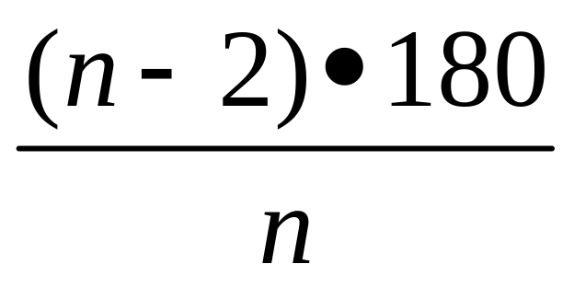
Regular Polygons
A REGULAR polygon is Equilateral and
Equiangular (all sides and all angles ).
To Find the measure of each Interior Angle of a regular convex polygon.

Slide 12
Ex. 8. Find the measure of each angle in a
regular convex octagon.
Ex. 9. The measure of each interior angle
of a regular polygon is 165º. How many
sides does the polygon have?

Slide 13
Exterior Angles
The Exterior Angle of any polygon forms
a linear pair with an Interior angle of a
polygon.
Ex. <1 is an exterior angle. <1 and <2 form a linear pair.
<1
<2
m<1 + m<2 = 180

Slide 14
Sum of the exterior angles of a convex polygon.
360º
ALL Exterior Angles of EVERY
polygon add up to 360º

Slide 15
Ex. 10. What is the sum of the exterior angles of a convex triangle?
Ex. 11. What is the sum of the exterior angles of a convex 300-gon?

Slide 16
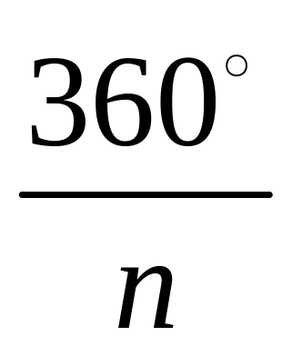
Regular Polygons
To Find the measure of each Exterior
Angle of a regular convex polygon.

Slide 17
Ex. 12. Find the measure of each exterior
angle of a regular heptagon.
Ex. 13. The measure of each exterior angle
of a regular polygon is 40º. How many sides
does it have?

